Slide 1
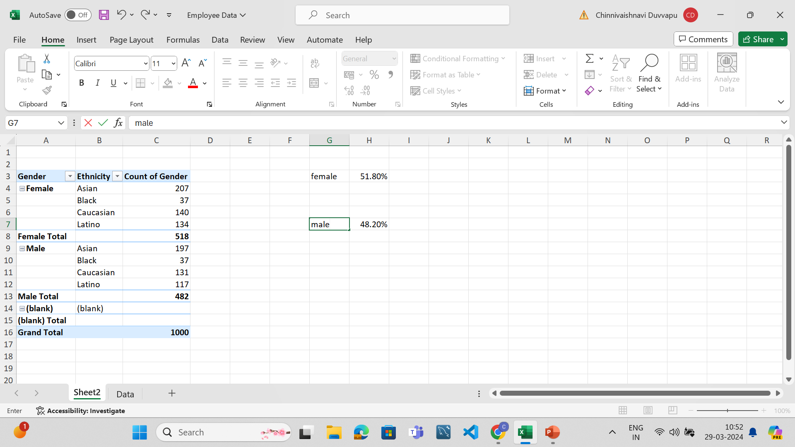
1.SUMMARY OF GENDER AND ETHNICITY DISTRIBUTION:
A: GENDER:
The female total is 518 and male total is 482.
So 51.8% are female and 48.2% are male.
So female distribution is > male distribution.
ETHNICITY DISTRIBUTION:
Asian distribution > Caucasian >Latino distribution > Black

Slide 2
2.AVERAGE EMPLOYEE STAY DURATION:

Slide 3
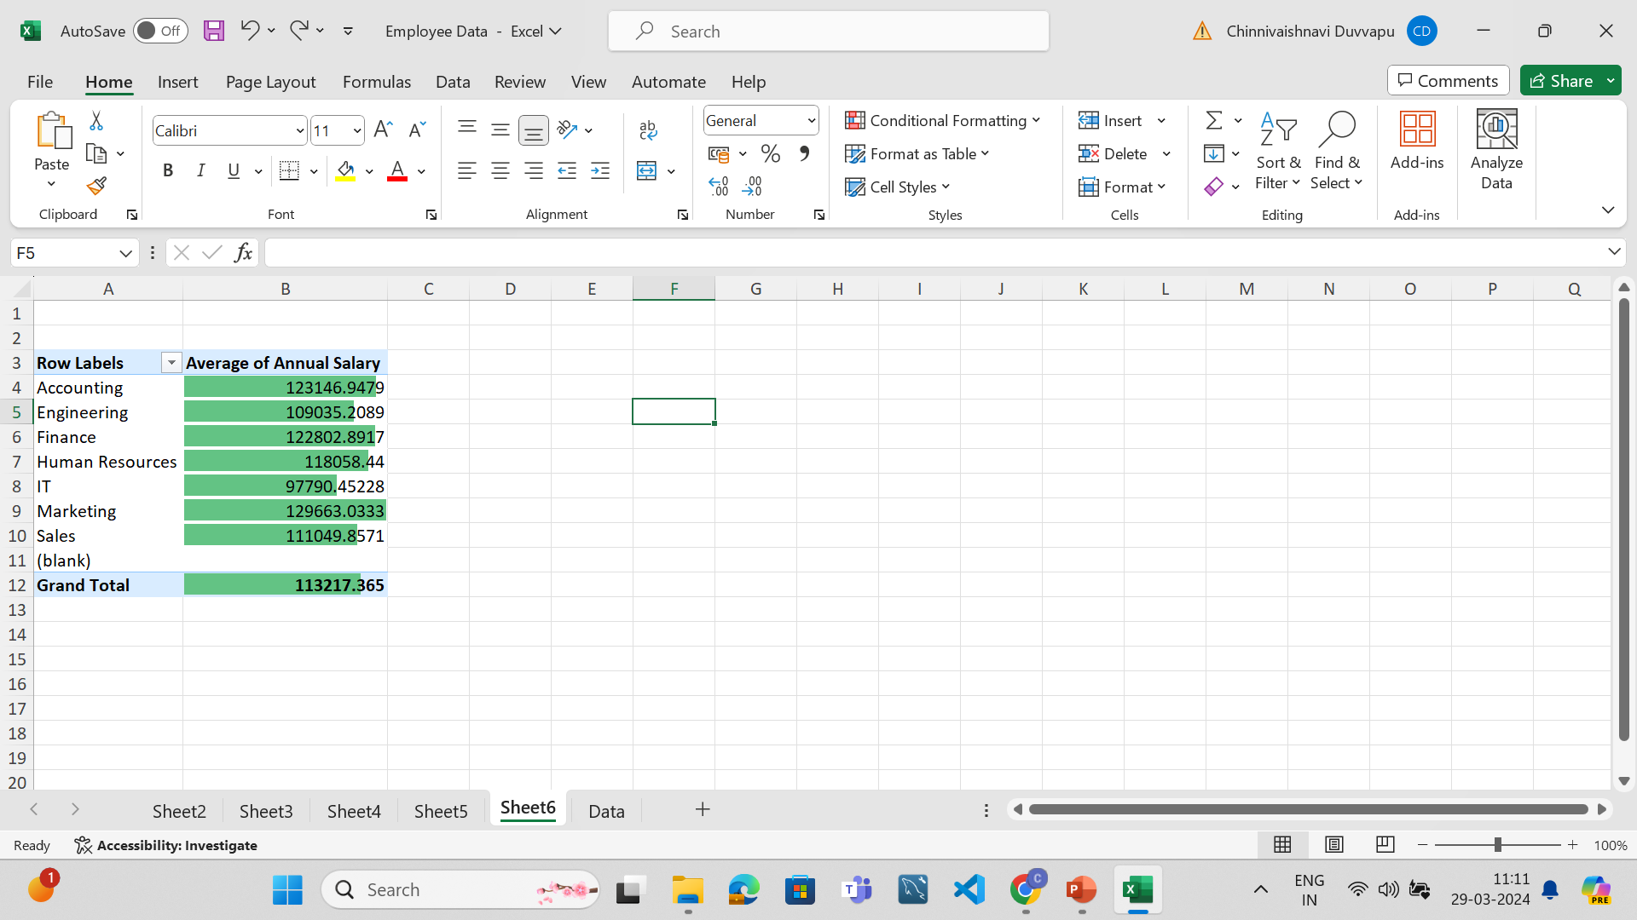
3. DIFFERENCE IN AVERAGE SALARIES BETWEEN DEPARTMENTS
A: There is a difference between the average salries of different departments but it is not very significant for some departments.
Marketing> accounting> Finance>Sales>hr>engineering >IT

Slide 4
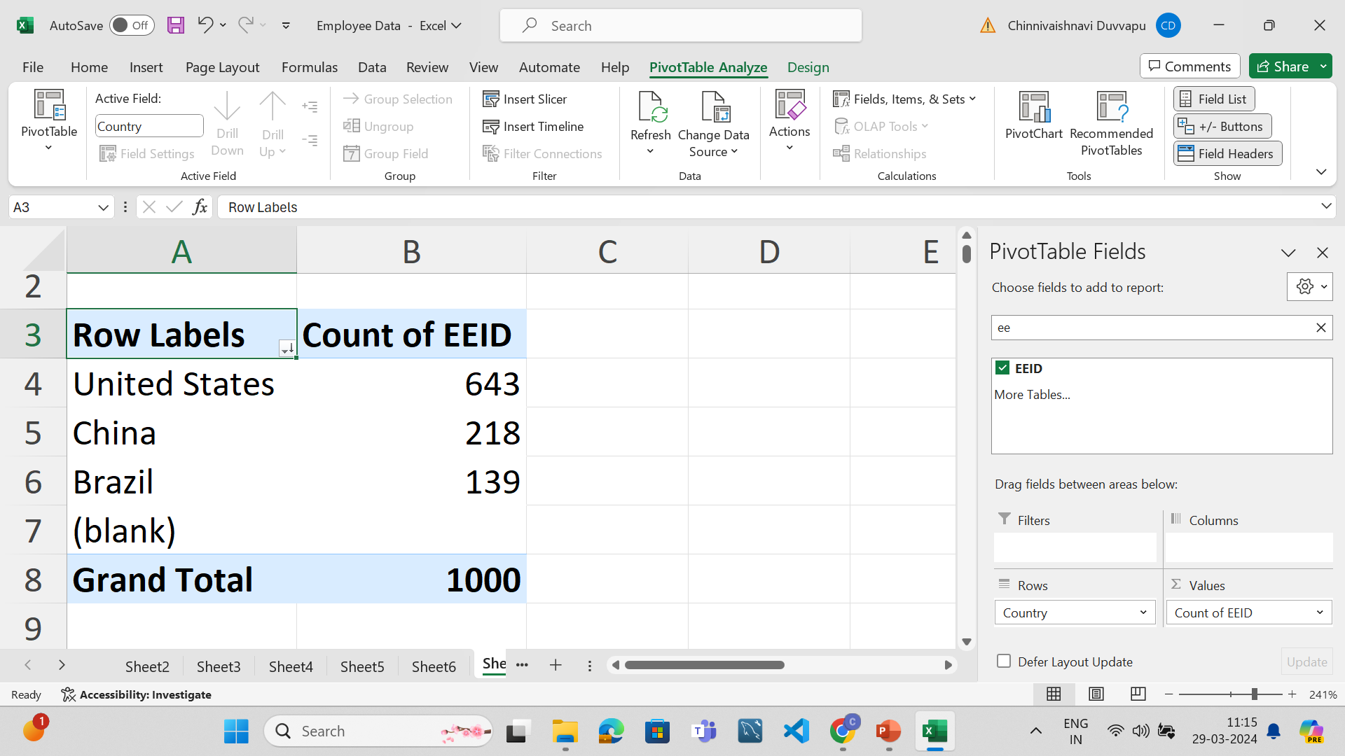
4.Which country has highest number of employees?
A: United States has highest number of employees

Slide 5
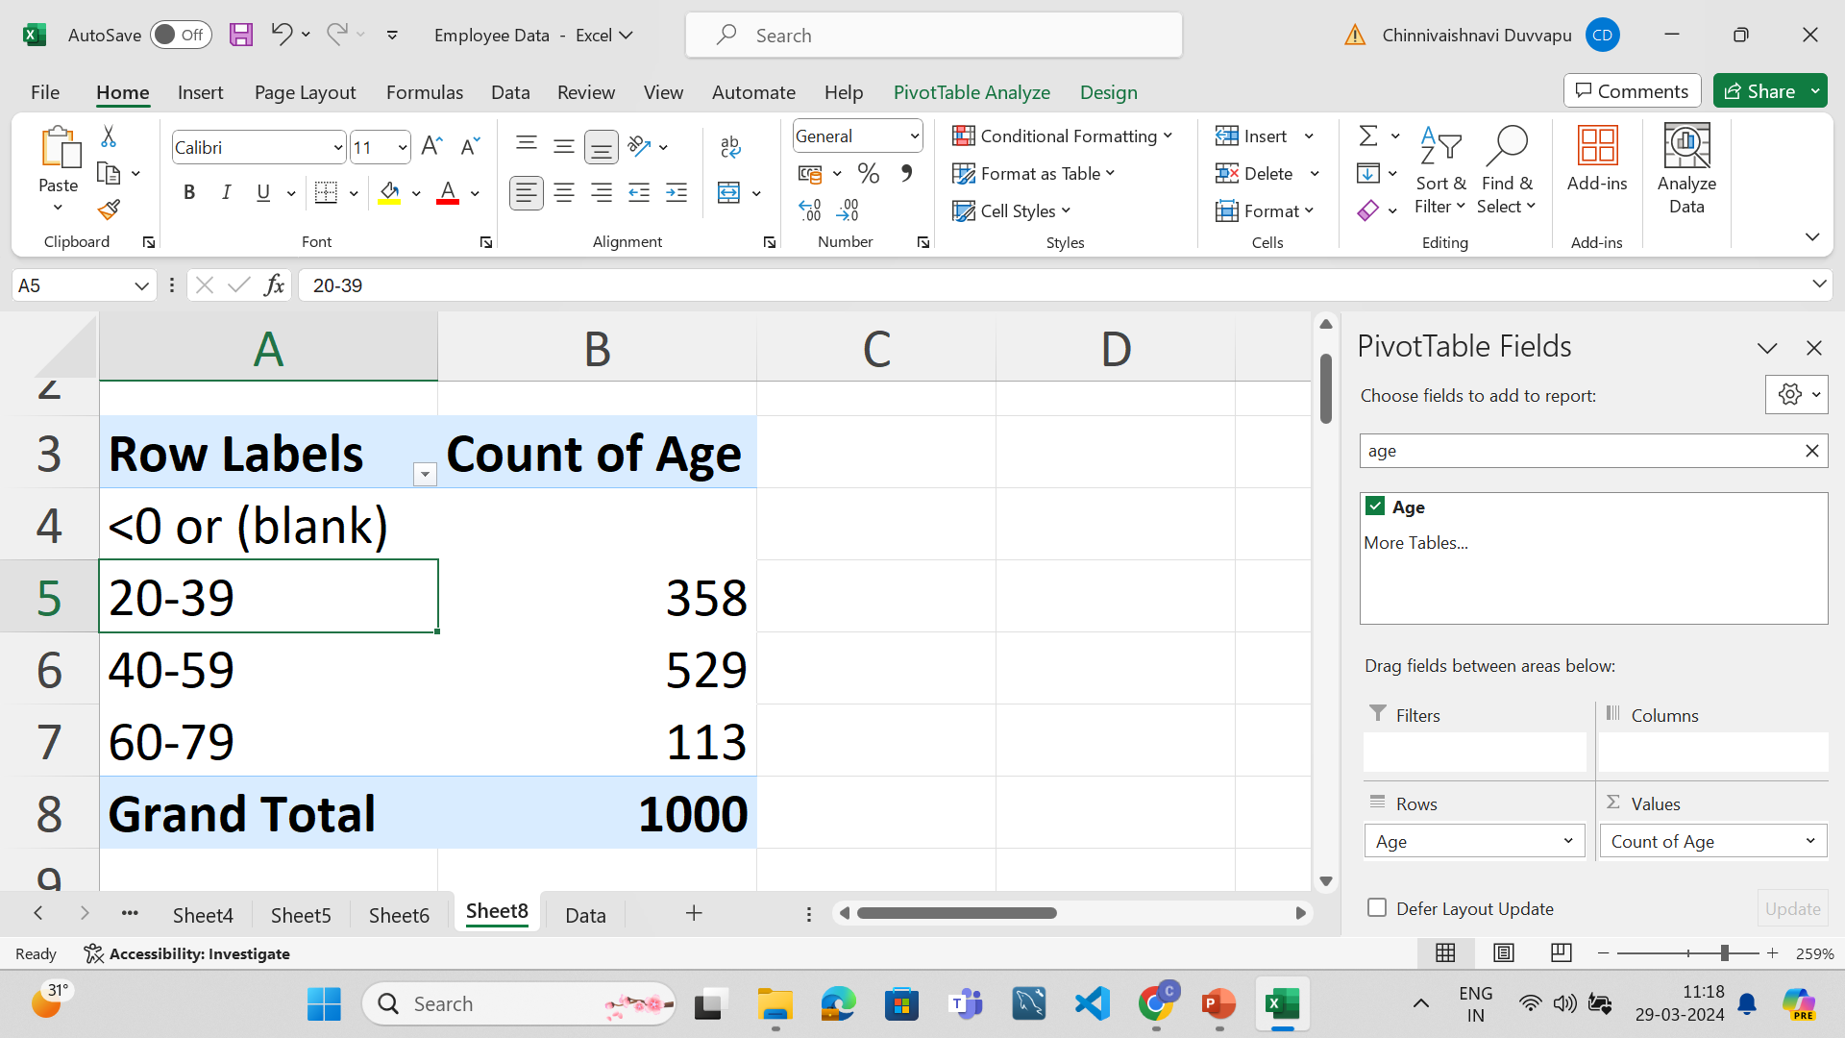
5. What is the most common age range in employees?
A: 40-59 is the most common age range in employees.

Slide 6
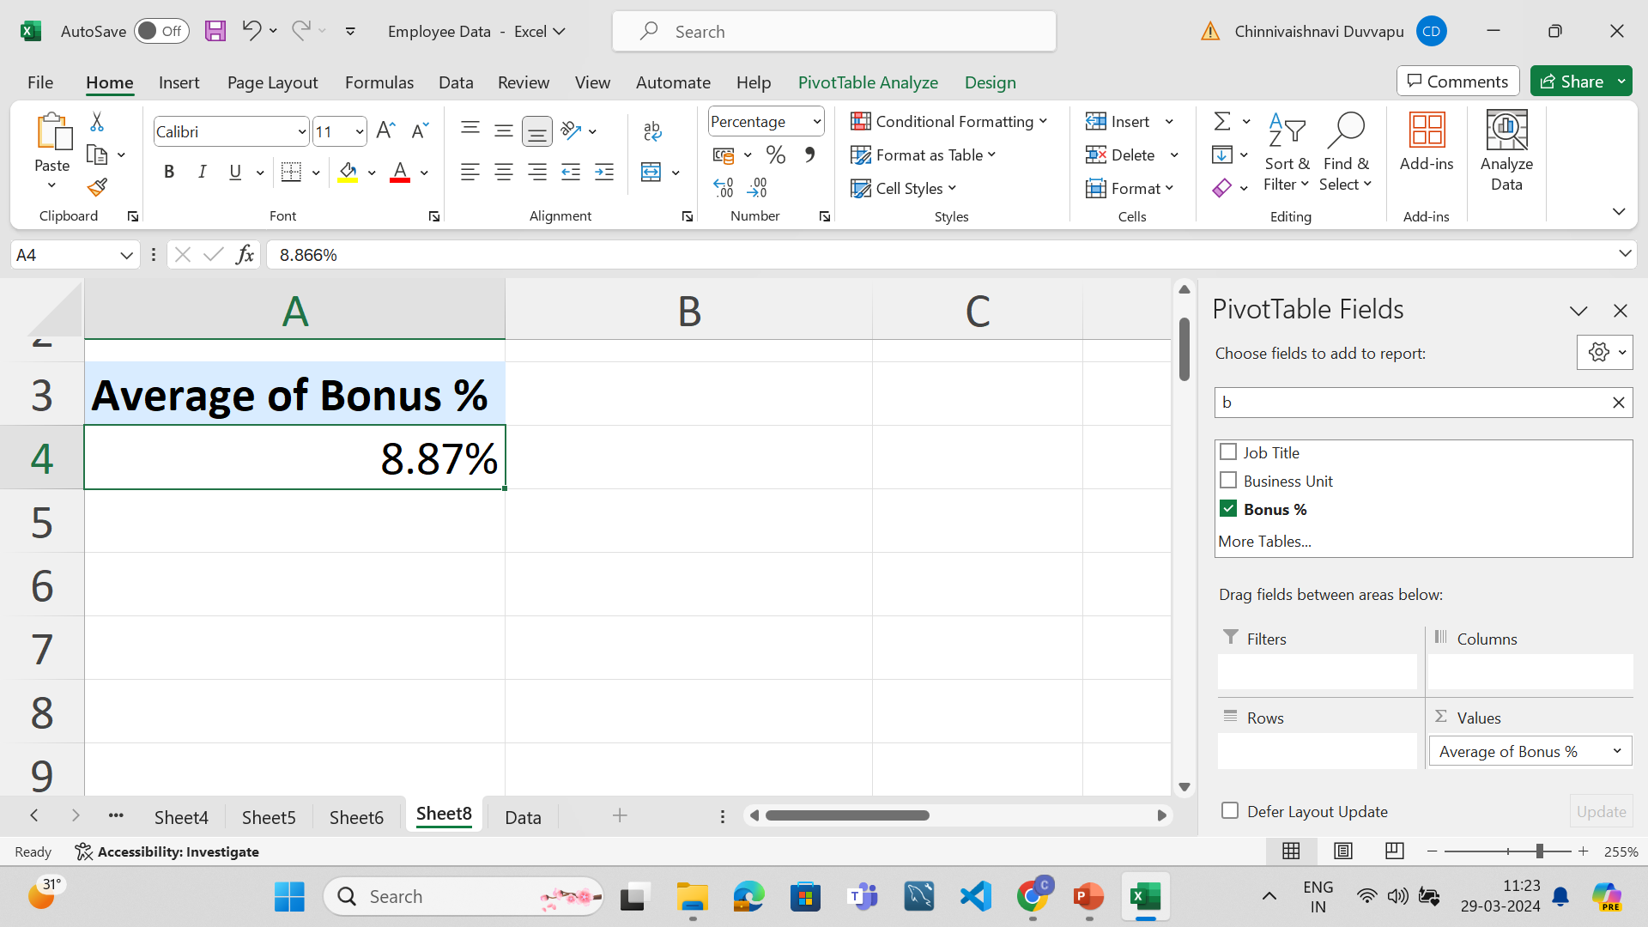
6.What is the average bonus percentage given to the emloyees?
A: 0.08866 i.e., 8.87% is the average bonus percentage given to employees

Slide 7
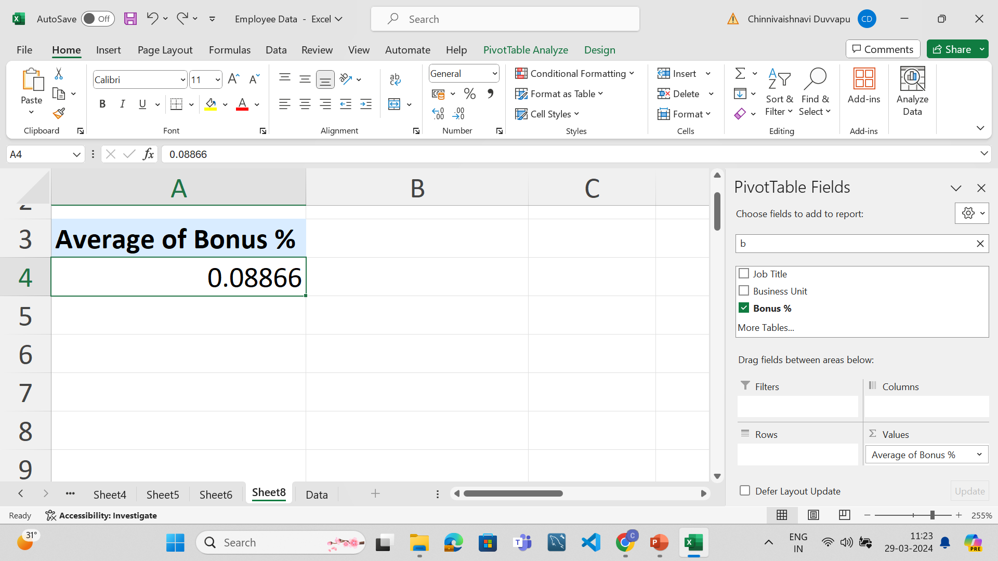

Slide 8
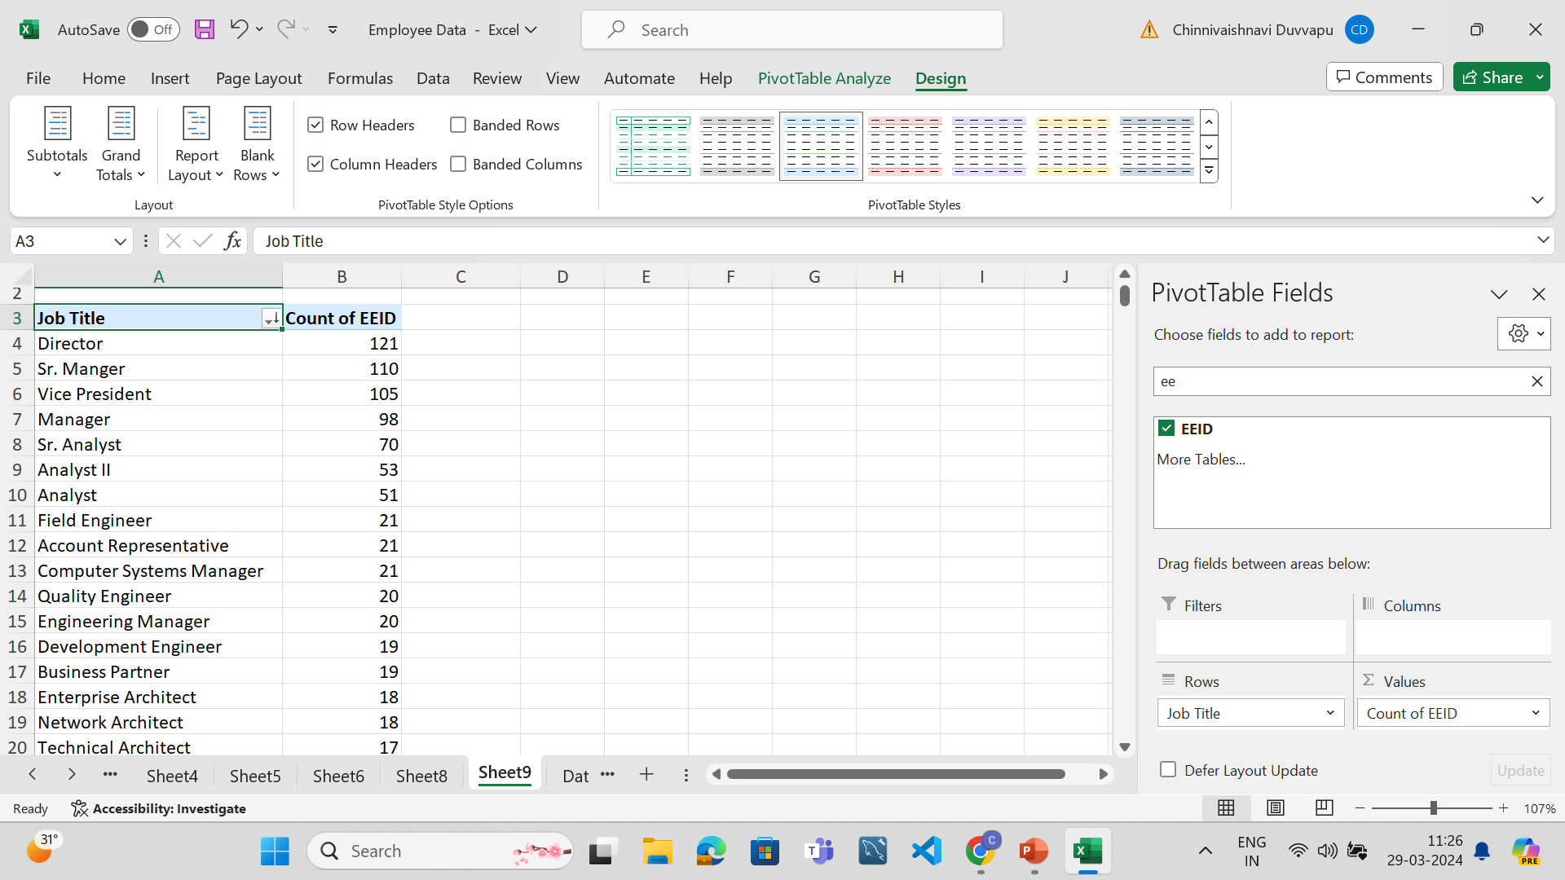
7.Which job title occurs mostly in the data set?
A: Director job title occurs the most.

Slide 9
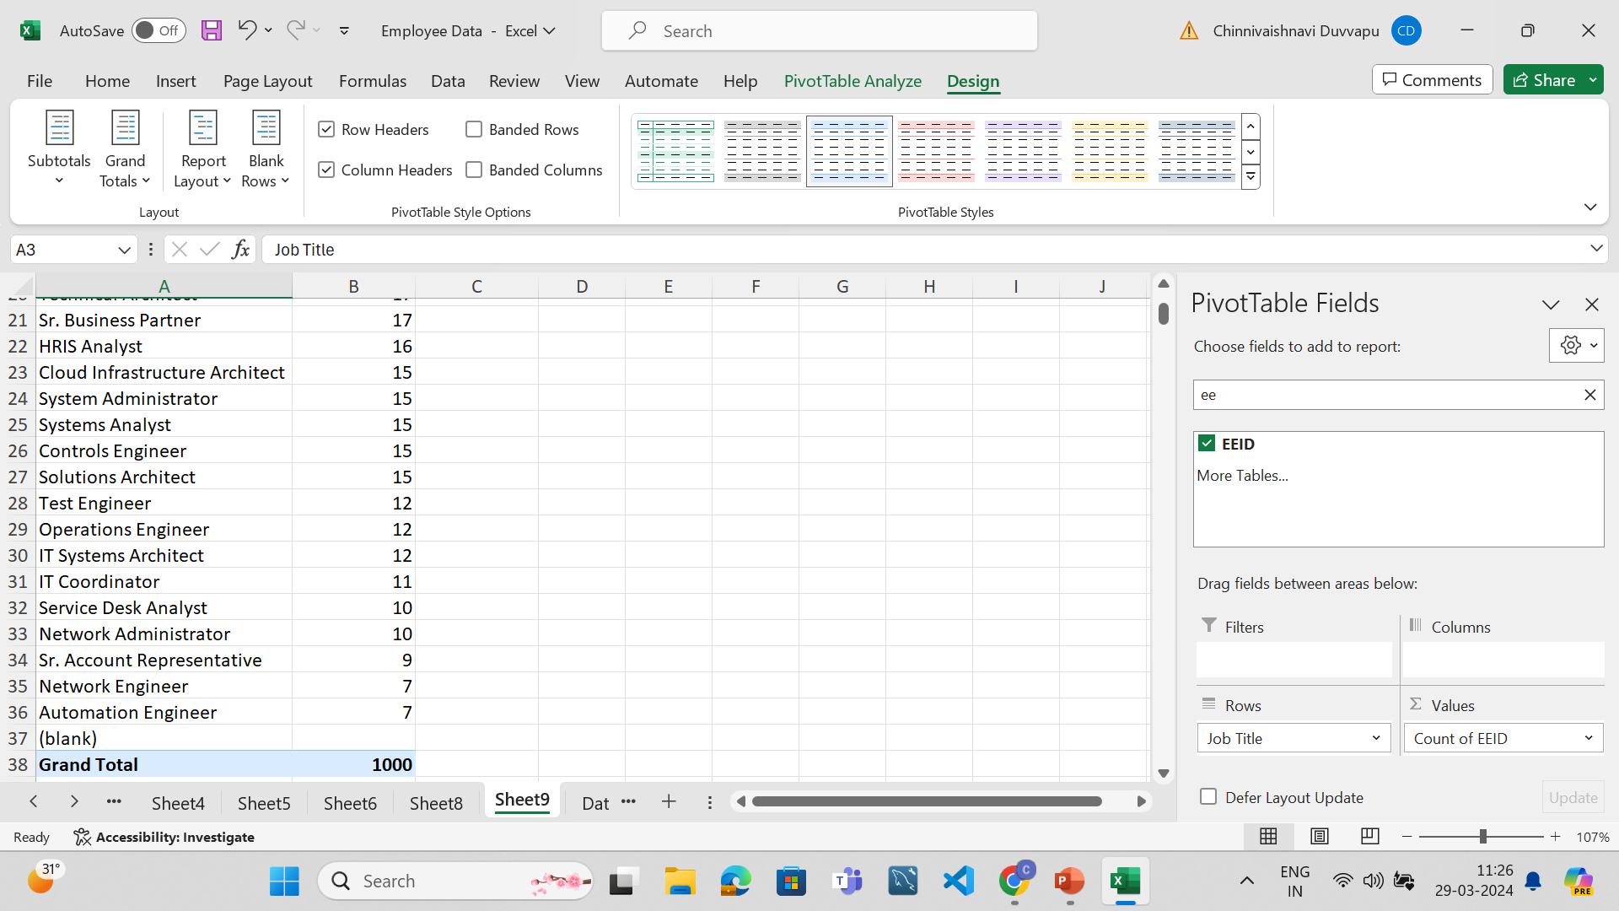

Slide 10
8.What are the primary reasons for employee exits?
A: Gender discrimination,
ethnicity distribution
difference in bonus
increase in age
difference in annual salary
country and city of workplace etc may be the reasons for employee exits.

Slide 11
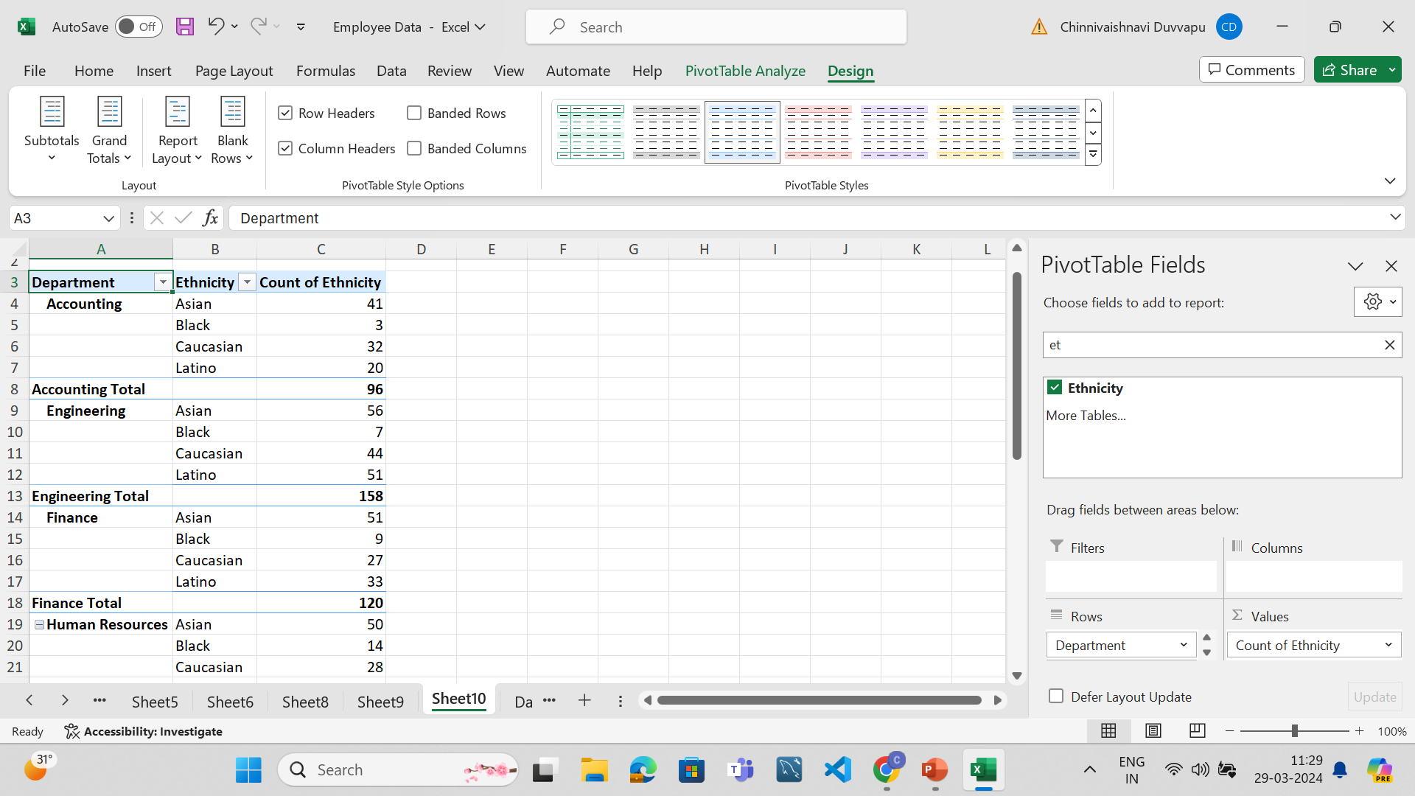
9..
A: Yes,different departments differ in the distribution of ethnicity.
Engineering,Finance,Human Resources, Sales have similar distribution i.e., Asian>latino>Cacausian>Black
For accounting,IT and Marketing it os Asian> Cacausian>Latino>Black

Slide 12
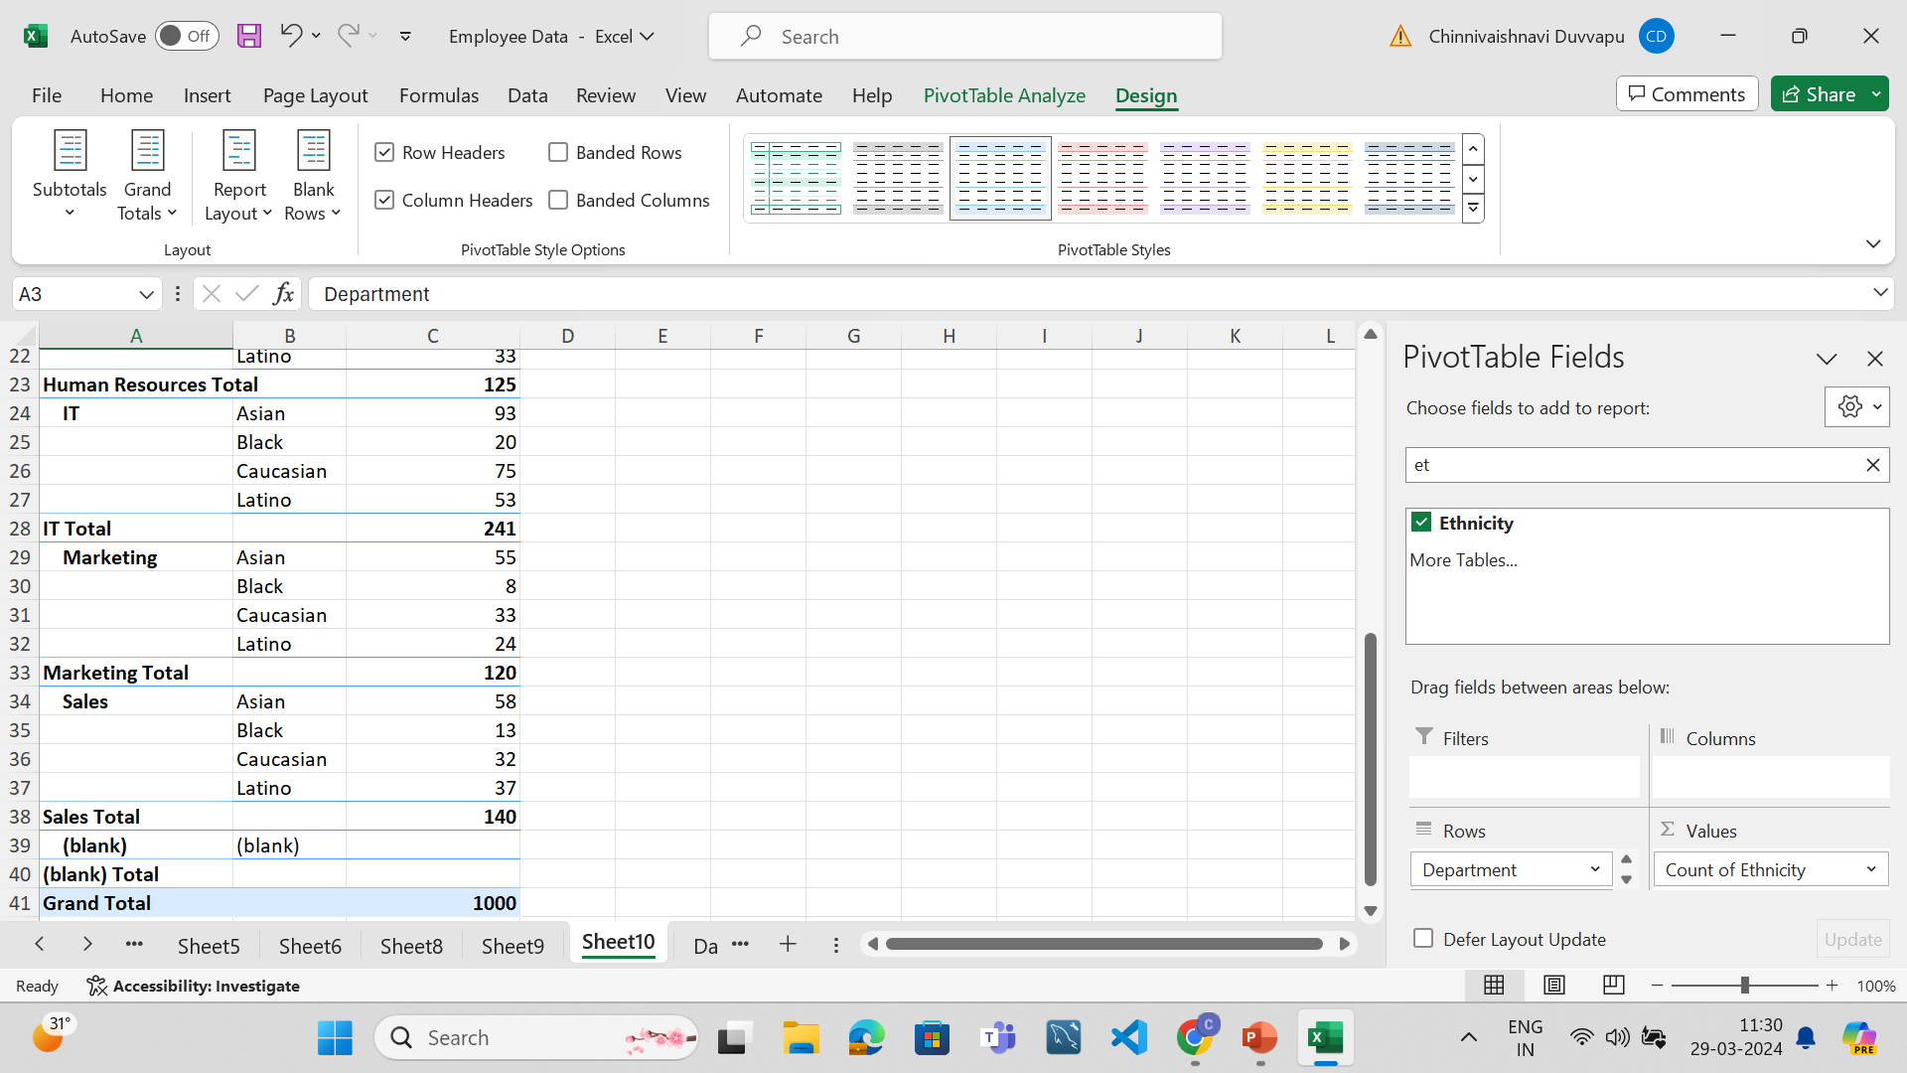

Slide 13
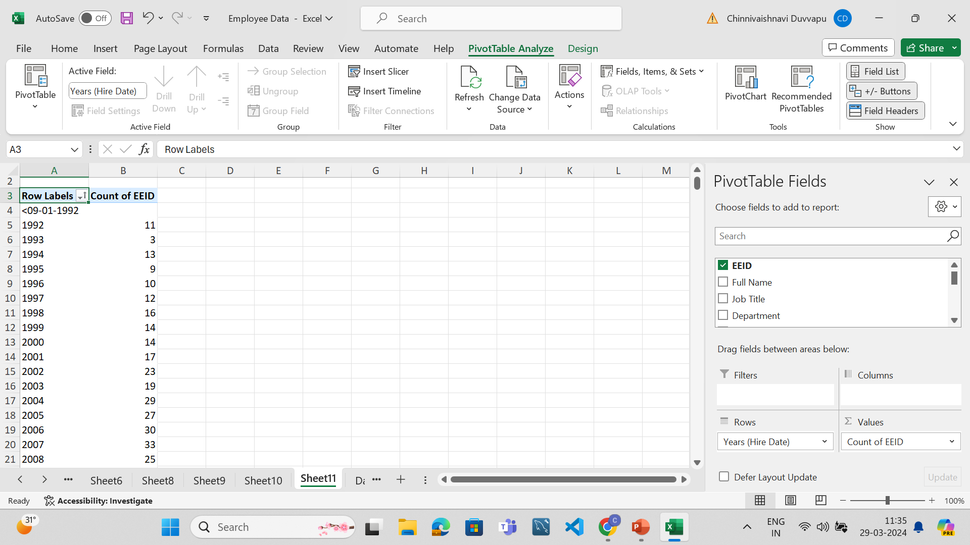
10.
A:There is an increase in hires in the number of employees over the past few years.

Slide 14
